Slide 1


Strategy for Purchasing and Support
PRESENTATION ON
Creating and maintaining brand on web and business models

Slide 2
PRESENTED BY
Supply chain management
Logistics and support Activities
Elements of Branding
Website Naming
Purchasing, Logistics and Support Activities
EDI ( electronic data interchange )
Steps for Reaching Targeted customer
Steps for Reaching Targeted Market
1
2
3
4
Kristina Udash
Keshab Dhungana
Ishwor Khatiwada
Kamal Koirala
2

Slide 3
Purchasing Logistics and Support Activities
Purchasing Activities
Identifying Vendors
Evaluating Vendors
Selecting Specific Products
Placing Orders
Resolving any issues that arise after receiving the order.

Slide 4
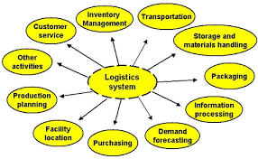
Logistics Activities
Provide the right goods in the right quantities in the right place at the right time
Businesses have been increasing their use of information technology to achieve this objective.
Source: google.com

Slide 5
Electronic Data Interchange
EDI is a computer-computer transfer of business information between two businesses that uses a standard format.
It includes information on paper invoices, purchase orders, request for quotations, bill of landing and receiving reports.

Slide 6
EDI : HISTORY
1950’s
1960s
Get a modern PowerPoint Presentation that is beau 1960s tifully designed. Easy to change colors, photos and Text.
Get a modern PowerPoint Presentation that is beautifully designed.
Get a modern PowerPoint Presentation that is beau 1960s tifully designed. Easy to change colors, photos and Text.
Get a modern PowerPoint Presentation that is beautifully designed.
1970’s
190s
Get a modern PowerPoint Presentation that is beautifully designed. Easy to change colors, photos and Text.
Get a modern PowerPoint Presentation that is beautifully designed.
Get a modern PowerPoint Presentation that is beautifully designed. Easy to change colors, photos and Text.
Get a modern PowerPoint Presentation that is beautifully designed.
6

Slide 7
How EDI Works?
Buyer prepares an order in his/her purchasing system and has it approved
EDI order is translated into EDI document format called 850 purchase order
850 purchase is then securely transmitted to supplier via internet

Slide 8
Supply Chain Management
The part of the industry chain that precedes a particular strategic business unit is called supply chain
The process of taking the active role in working with suppliers to improve products and processes is called supply chains management(SCM)
SCM was originally developed as a way to reduce costs
Clear communications and quick response are a key elements of successful SCM

Slide 18
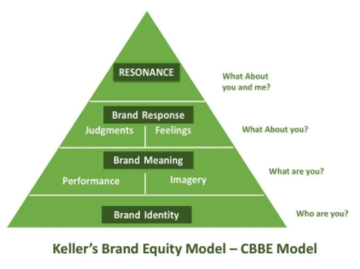
Creating and Maintaining brand on web and business model
Brand identity is determined by your business goals.
Analysis, design and marketing plays vital role for maintaining a brand.
Source: photos.google.com

Slide 19
Steps for Reaching Targeted Customers
Survey Customers(web/posters)
Social media marketing(free/paid/SEO)
Affiliate Marketing
Research about Competitors
Traditional marketing approches (stall, seminar etc.)

Slide 20
Steps for Reaching Targeted Market
A target market refers to a group of potential customers to whom a company wants to sell its products and services.
The four main types of market segmentation are:
Demographic : age, gender, education, marital status, race, religion, etc.
psychographic: values, beliefs, interests, personality, lifestyle, etc.
Behavioral : purchasing or spending habits, user status, brand interactions, etc.
Geographic : neighborhood, area code, city, region.
CONTD………

Slide 21
Steps for Reaching Targeted Market
Speak directly to a defined audience
Differentiate your brand from competitors
Build deeper customer loyalty and trust
Improve products and services
Stay focused(Right person at Right time)

Slide 22
THE END
“Please feel no hesitation for any questioning attitude” ?

